Slide 1
The Complexities of Authorship Heather Lea Moulaison, PhD
SISLT iSchool Lunch and Learn
October 3, 2013
Notes:
Abstract: What does it mean to be an author today? The role of the author, her corrector(s)/editor(s), and the publishing industry are changing rapidly. This presentation will merge two ongoing research streams to explore some of the intricacies of authorship in the digital age.

Slide 2
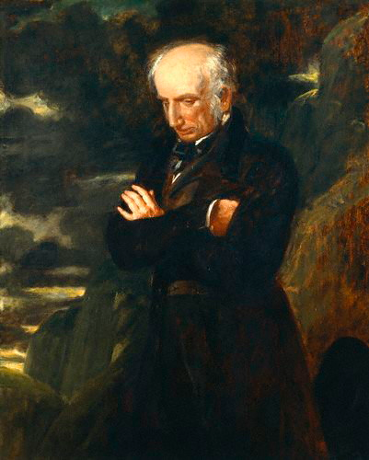
Author as (tortured, solitary) genius
Romantic notions of the author situated him as a solitary genius.
Sometimes, he was even a tortured genius!
Christine Haynes, “Reassessing ‘Genius’ in Studies of Authorship: The State of the Discipline,” Book History, 8 (2005) 287-320.
William Wordsworth by Benjamin Robert Haydon oil on canvas, 1842 http://en.wikipedia.org/wiki/File:William_Wordsworth_001.jpg

Slide 3
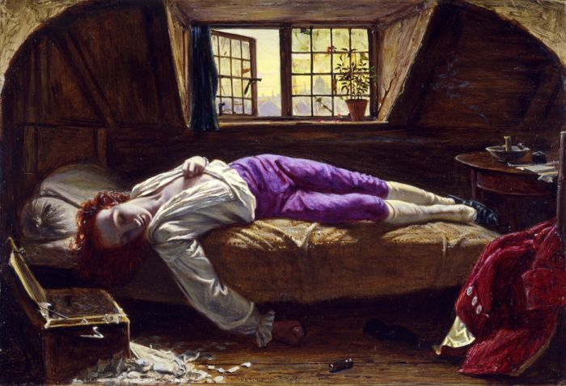
The Death of Chatterton, 1856, by Henry Wallis
http://upload.wikimedia.org/wikipedia/commons/5/54/Chatterton.jpg

Slide 4
Agenda
Authorship
Issues of convergence
Publishing
Issues in self-publishing
Organization of information
Issues of access to materials via “authors”

Slide 5
Authorship

Slide 6
What is authorship?
Barbour thinks the current meaning of authorship is worthless, it is being exploited and gamed and doesn’t encompass the full scholarly spectrum (e.g. blogs, reviews, tweets). We need to rethink authorship in the digital age and not just technically. Robust definitions that are portable across specialties and methods for attribution at different levels need to be developed. The time has come to “throw out the term ‘author’”.
IWCSA Report (2012). Report on the International Workshop on Contributorship and Scholarly Attribution, May 16, 2012. Harvard University and the Wellcome Trust. http://projects.iq.harvard.edu/attribution_workshop

Slide 7
The notion of authorship over time
Authors and not titles are through modern history the focus of western bibliography, with “attribution of a given text to a known ancient authority [being] essential to determining the text’s veracity” in the middle ages.
Think about how we cite references in our bibliography as an example…
(Koppel, Schler, & Argamon, 2008, p. 9).

Slide 8
The notion of authorship over time
In general we can say that, long after the invention of printing, there was no such thing as an “author” in the modern sense of the term. Even if the term “author” (autheur in Latin and auteur in French, according to Cynthia Brown) began to appear as early as the sixteenth century, it retained the medieval connotations of “authority” and “actor,” as opposed to “genius” or “subjectivity,” until the late eighteenth or early nineteenth century (even in America, according to Grantland Rice).
Christine Haynes, “Reassessing ‘Genius’ in Studies of Authorship: The State of the Discipline,” Book History, 8 (2005) 287-320, p. 310. Citing Rice, Transformation of Authorship in America, 5–6 and 53. Masten’s Textual Intercourse provides a clear discussion of the overlapping meanings of “author” in early modern England, 64–66.

Slide 9
The fluid notion of authorship
Even in this period of genius associated with authorship, there was the expectation that dandy authors outlined ideas, and that their servants would write out the text while they were out
Stendhal as an example
Additionally, editors have been playing a primary role in the shaping of fiction during that same time period.
Those editors are generally associated with the publishing industry and the process of publication

Slide 10
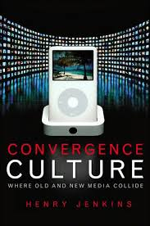
Convergence culture
A format-agnostic focus on content
The use of technology to create, share, and access content that could not have otherwise existed.
Convergence culture is notably participatory.
E.g. Harry Potter fan fiction among the community of young readers
What shady best-seller also began as fan-fiction?

Slide 11
Authorship’s evolution in the age of convergence
“Examples are numerous and represent the complexity of the publishing environment that is arising through the Internet. The bestselling trilogy, 50 Shades of Grey apparently started as a Twilight-based fan fiction novella called Masters of the Universe, distributed by an Australian fan-fiction publisher, The Writer’s Coffee Shop.”
In this example, then, who is the genius author?
Also, does it matter that the book was self-published before being picked up by a big-name publishing house?
Brantley, P. (2012). The New Missing Books, Pub Res Q 28:172–175. DOI 10.1007/s12109-012-9283-2

Slide 12
Publishing

Slide 13
What’s in a name?
Q. What is the difference between an author and a writer?
A. We assume authors have been published.
But what does it mean to be “published” in this day and age?

Slide 14
Author services
Author services self-publishing models, employing print on demand (POD), became popular in the early 2000s (Dilevko & Dali, 2006) and have provided a venue for self-publishers to print smaller runs of books successfully, allowing authors to “dispense with publishers in the traditional sense and become their own publishers” (Jobson, 2003, p. 20).

Slide 15
The rise of self-publishing
Bowkers 2009 data indicates that two-thirds of books published were from nontraditional publishers (Bradley, Fulton, & Helm, 2012), indicating the lessening of the self-publishing stigma.
If you don’t believe it, go visit the EBM in the Mizzou Store on Oct. 5 to learn more:

Slide 16
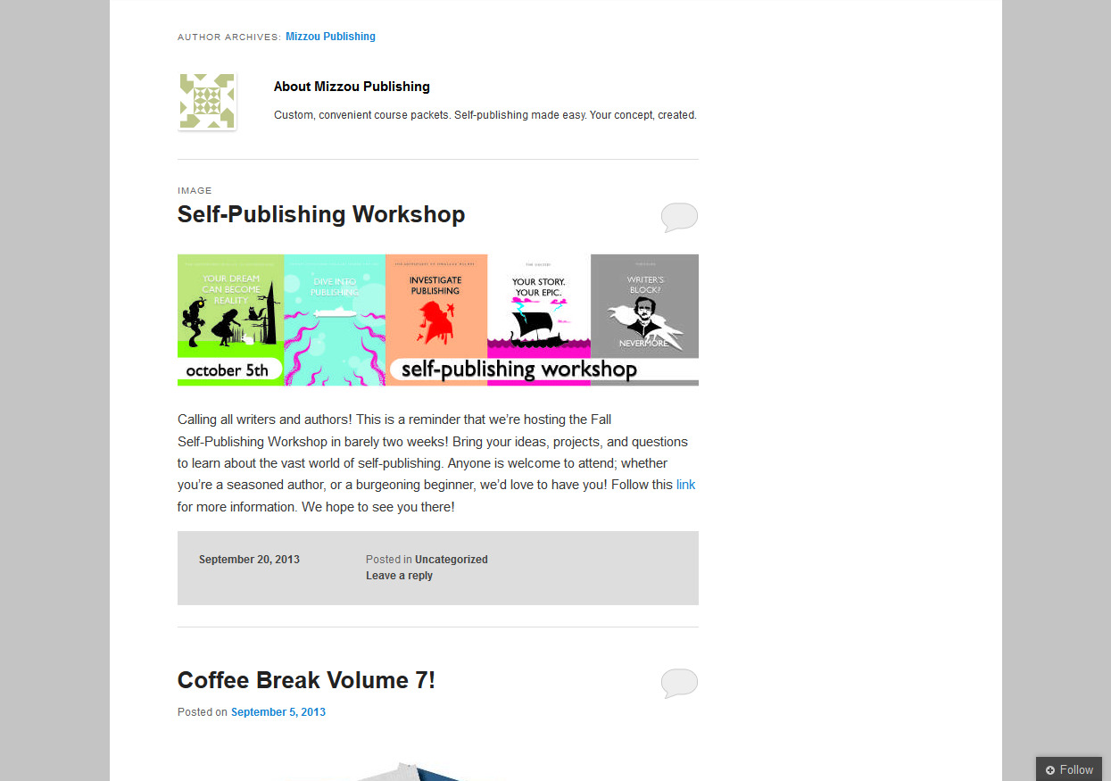

Slide 17
Organization of Information
Access in libraries to materials created (and published) by authors

Slide 18
Principles of library access
Despite updates, still largely based on Cutter’s (1904) Objects for a Dictionary Catalog
Three primary functions of the catalog:
finding [materials]
collocation [of materials -- by criteria], and
selection [of materials, based on their attributes].
The author in her own right has not been a focal point of interest to modern librarians.
Cutter, C. A. (1904). Rules for a dictionary catalog 4th ed., rewritten. Washington: Government Printing Office. UNT Digital Library. Retrieved from: http://digital.library.unt.edu/ark:/67531/metadc1048/

Slide 19
In the bibliographic universe,
Content is king!
The 1998 Functional Requirements for Bibliographic Records (a relationship-entity model) considers materials collected in libraries to be first…

Slide 20
FRBR Group 1 Entities
Work
is realized through
Expression
Intellectual/Artistic Content
is embodied in
Physical – Recording of Content
Manifestation
one
is exemplified by
many
Item
Notes:
20
These four entities in Group 1 are the product of intellectual and/or artistic endeavor – the content and the packages that contain that content – all of the bibliographic resources that we want to make available to our users – the things libraries collect or provide access to. The model calls these work, expression, manifestation, and item. The entities form a hierarchy with work at the top of the model so it may help to see them in a diagram as here.
This diagram begins to show how the Group 1 entities are related to each other.

Slide 21
New approaches to the bibliographic universe
FRBR represents a new way of thinking about library data in the digital age
It is the foundation of the new cataloging code, RDA
RDA has been in place since March 31, 2013
Documents related to FRBR include conceptual models for thinking about authors as persons in the bibliographic universe.
Functional Requirements for Authority Data (FRAD)
(also FRSAD for subject authority data)

Slide 22
Functional Requirements for Authority Data (FRAD)
Ideal: 14 attributes to be recorded for authors in library systems (FRAD)
In practice:
9 are really “allowed” in library data about authors
none are required
In the six months since the new cataloging code’s been implemented, it’s unclear how much traction these new fields have gotten

Slide 23
Fields in author records (in libraries)
Code | Description
046 | Special Coded Dates (R)
370 | Associated Place (R)
372 | Field of Activity (R)
373 | Associated Group (R)
374 | Occupation (R)
375 | Gender (R)
376 | Family Information (R)
377 | Associated Language (R)
378 | Fuller Form of Personal Name (R)
678 | Biographical or Historical Data

Slide 24
Authorship in digital systems
Authorship is more complex than the schematic for “Group 1 entities” we saw shows…
And authors are more complex than the data we can record about them in library systems!
Consider the data that Wikipedia records about authors in the text boxes…

Slide 25
Wikipedia permits the addition non-traditional attributes:
achievement
age
astrologicalSign
award
bodyDiscovered
bustSize
citizenship
complexion
deathCause
ethnicity
eyeColor
hairColor
hasNaturalBust
hipSize
honours
ideology
measurements
militaryBranch
nationality
networth
noteOnRestingPlace
party
philosophicalSchool
piercing
restingPlacePosition
salary
shoeNumber
tattoo
waistSize
Thanks to Felicity Dykas for compiling this list

Slide 26
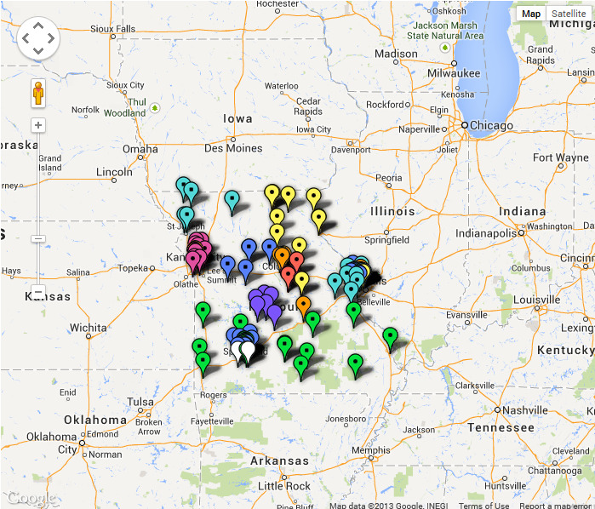
Study of author data in MERLIN
MERLIN: our cluster of academic libraries in MO
Library data (pn authority records) about authors for the MERLIN cluster was downloaded on September 30
In the past three days, I have frantically been analyzing these records!
Thanks to Felicity Dykas for pulling this data

Slide 27
Preliminary results
1,156,315 records pulled
All used as “authors” and not as “subjects” in MERLIN bibliographic records
Pulled as four Excel files
6,500 records retained for analysis
4606 records (70.8%) with no additional data
1895 records (29.2%) with some additional data included in the record

Slide 28
Description | # records with content in the field | % of total pull N=6500 | % of records with some data n=1895 | Records with multiples of a single field
Special Coded Dates (R) | 1434 | 22% | 75.7% | 3
Associated Place (R) | 250 | 3.8% | 13.2% | 4
Field of Activity (R) | 128 | 2.0% | 6.8% | 4
Associated Group (R) | 100 | 1.5% | 5.3% | 22
Occupation (R) | 289 | 4.4% | 15.3% | 29
Gender (R) | 318 | 4.9% | 16.8% | 0
Associated Language (R) | 248 | 3.8% | 13.1% | n/a
Fuller Form of Personal Name (R) | 116 | 1.8% | 6.1% | n/a
Biographical or Historical Data | 1393 | 21.4% | 73.5% | n/a

Slide 29
Discussion
Almost ¾ of records with content had values in the fields that have been in existence longer than 6 months
Of the new fields, not much data has been provided
Our future ability to group materials by attributes of their authors is severely limited
Grouping all writings of
Nobel laureates in physics
Female poets living in England during the renaissance
Young transgender individuals

Slide 30
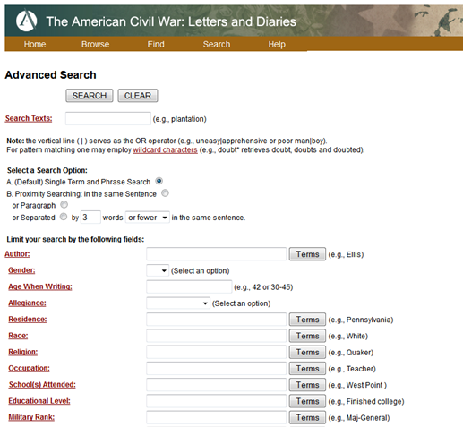

Slide 31
Conclusion
Until we can decide what authorship means today, it will be difficult to provide meaningful access to library materials
As publishing evolves and authorship becomes more intellectually diffuse, the role of the library (and publishing) will have to adapt

